Slide 1
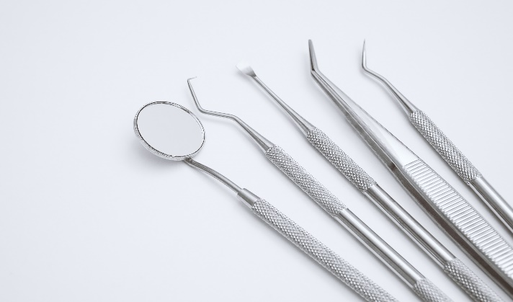
Dental Plan
high cost of dental disease and surgery. Dental coverage is offered for basic and major services.
The dental plan also includes 100% coverage for
In addition to protecting your smile, dental insurance preventive care. You and your eligible dependents may
helps pay for dental care and includes regular checkups, cleanings and x-rays. Receiving regular dental care can protect you and your family from the
enroll in one of the two dental coverage options administered by Delta Dental.
Dental Plan* | Base | Buy - Up
Plan Features
Annual Deductible Individual/Family | $50/$150 | $50/$150
Annual Maximum Per Person | $1,500 | $2,000
Preventive Care Routine Cleanings, Exams (twice a year) | Covered 100% | Covered 100%
Basic Services Fillings, Routine Extractions | 20% after deductible | 20% after deductible
Major Services Crowns, Dentures, Bridges | 50% after deductible | 50% after deductible
Orthodontia Children up to age 18 | 50% after deductible | 50% after deductible
Orthodontia Lifetime Maximum (Per Person) | $1,000 | $1,000
*You have the option to visit any dental provider you wish, but you will pay less by utilizing in-network care.
Maximum rollover feature
Both plans allow members and dependents to rollover a portion of their unused annual dental plan maximum into an individual Maximum Rollover account for future use. You can rollover up to 25% of the unused portion per year up to a maximum of $500.
See plan details at www.deltadentalnj.com for qualification criteria and requirements.
Access your dental coverage
To review your benefits and eligibility information, find in-network dentists, track claims, get cost estimates, print additional copies of your ID card, and more, please see the contact information below.
Save money with a PPO network dentist
Save money with Delta Dental’s PPO network dentists for deeper discounts and higher benefits. Beware of balance billing with out-of-network dentists, which can lead to additional costs beyond your plan's coverage limits.
www.deltadentalnj.com 800-452-9310
Download the app

