Slide 1
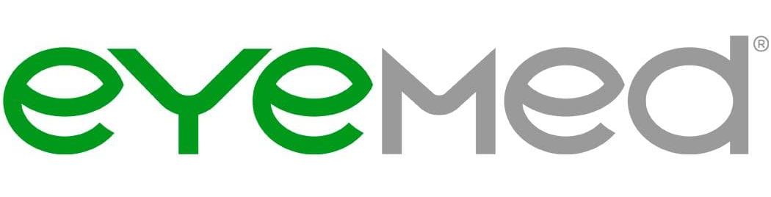
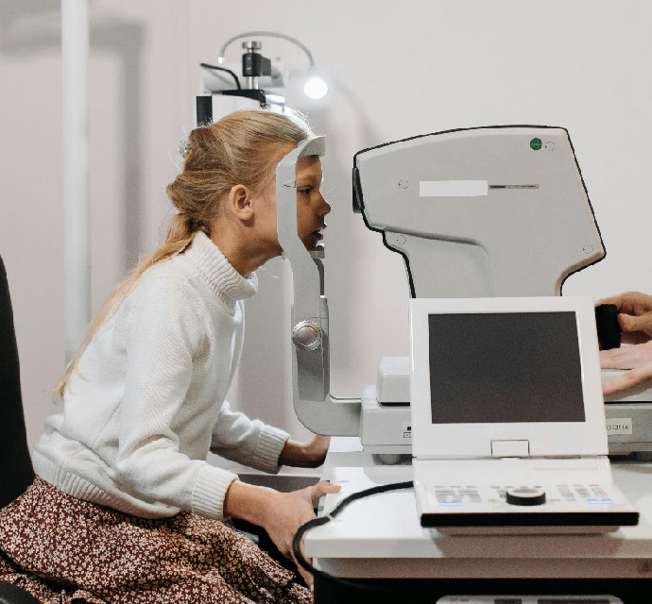
Vision Plan
Driving to work, reading a news article and watching TV are all activities you likely perform every day. Your ability to do all of these activities, though, depends on your vision and eye health. Vision insurance can help you maintain your vision as well as detect various health problems.
Your vision insurance is provided by EyeMed and entitles you to specific eye care benefits. Our policy covers routine eye exams and other procedures, and provides specified dollar amounts or discounts for the purchase of eyeglasses and contact lenses.
Vision Plan | Member Cost In-Network*
Plan Features
Eye Exam (Once Every 12 Months) | $10 copay
Lenses (Once Every 12 Months)
Single Vision - | $15 copay
Bifocal - | $15 copay
Trifocal - | $15 copay
Frames (Once Every 24 Months)*** | Up to $150 allowance: plus 20% off balance over $130
Contact Lenses** (Once Every 12 Months)
Medically Necessary - | Covered in full
Elective - | Up to $130 allowance plus 15% off any amount above allowance
*You have the option to visit any vision provider you wish, but you will pay less by utilizing in-network care
** In lieu of glasses
*** No out-of-pocket costs for frames at Target or Sears
Access your vision coverage
To check your coverage, access your vision card, find in-network eye doctors, view special offers and discounts, shop eyewear fashions, and more, please see the contact information.
www.eyemed.com 866-804-0982
Download the app

